Slide 1
Allsaints DATA TRACKING REFERENCE PHOTOS -moe

Slide 2
MONTHLY REPORT 2025
 | January | February | March | April | May | June | July | August | September | October | November | December
Actual AED
Benchmark AED
Growth %
Amount Growth AED |  |  |  | -

Slide 3
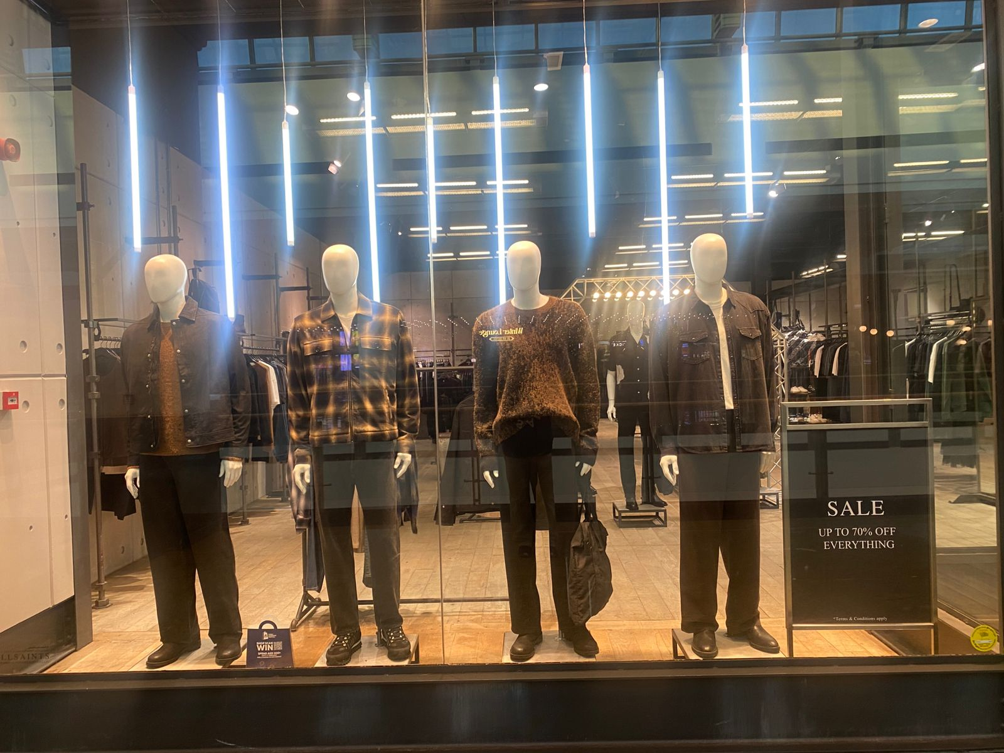
Menswear.Winter 2025.Events.January Update,
BRAND | ACTIVATION | DESCRIPTION | START DATE | END DATE | DURATION | UNITS SOLD | VALUE | BENCHMARK
MOE Allsiants | WINDOW | January directive | 01/05/2025 | 01/15/2026 | 2 weeks | 40 | 20,854.27

Slide 4
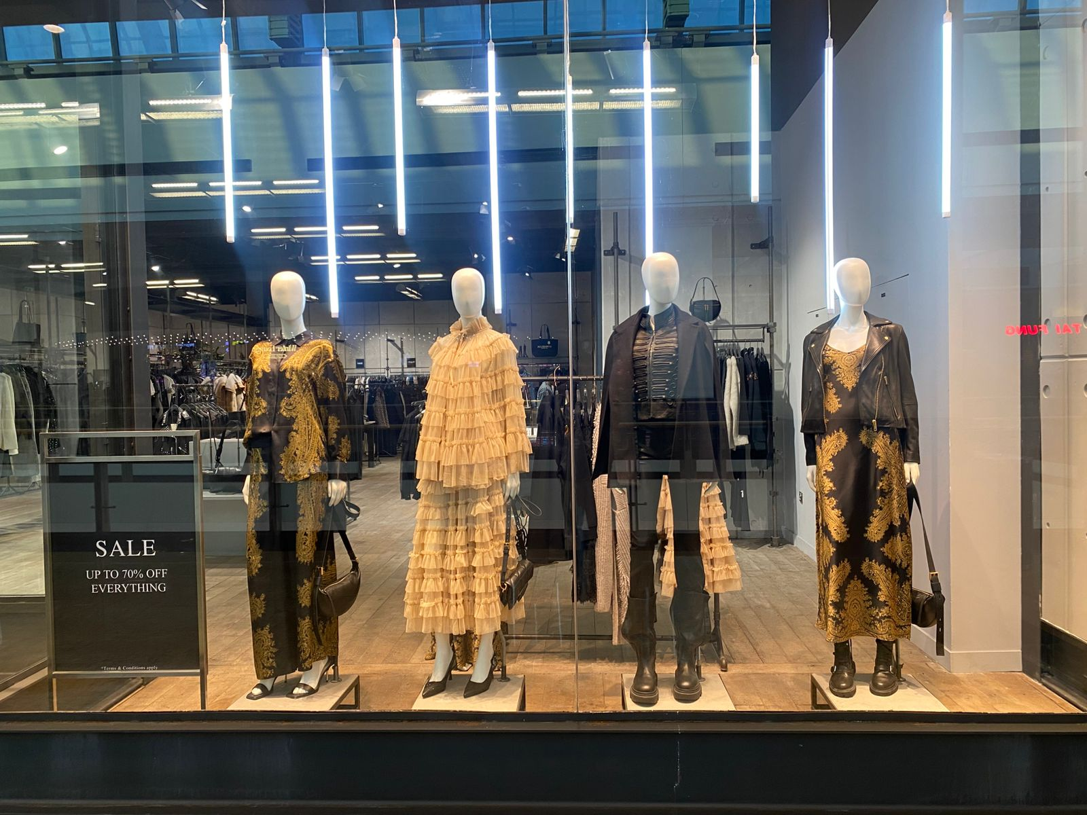
Womenswear.Icon.Winter 2025.January Update,
BRAND | ACTIVATION | DESCRIPTION | START DATE | END DATE | DURATION | UNITS SOLD | VALUE | BENCHMARK
MOE Allsaints | WINDOW | November directive | 01/05/2026 | 01/15/2026 | 2 weeks | 59 | 52,332.38

Slide 5
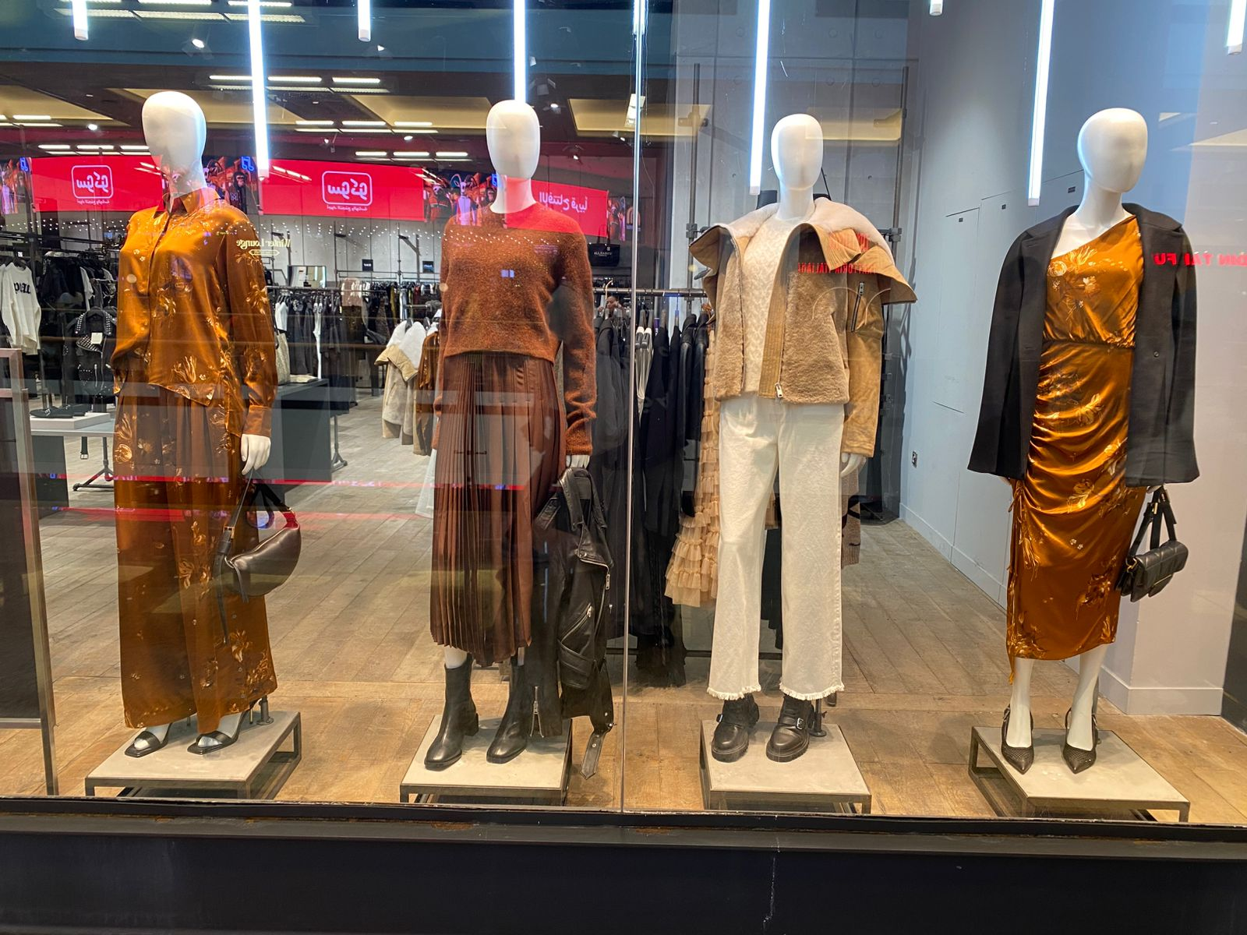
Womenswear.Icon.Winter 2025.January Update,
BRAND | ACTIVATION | DESCRIPTION | START DATE | END DATE | DURATION | UNITS SOLD | VALUE | BENCHMARK
MOE Allsaints | Entrance | November directive | 01/07/2026 | 01/15/2026

Slide 6
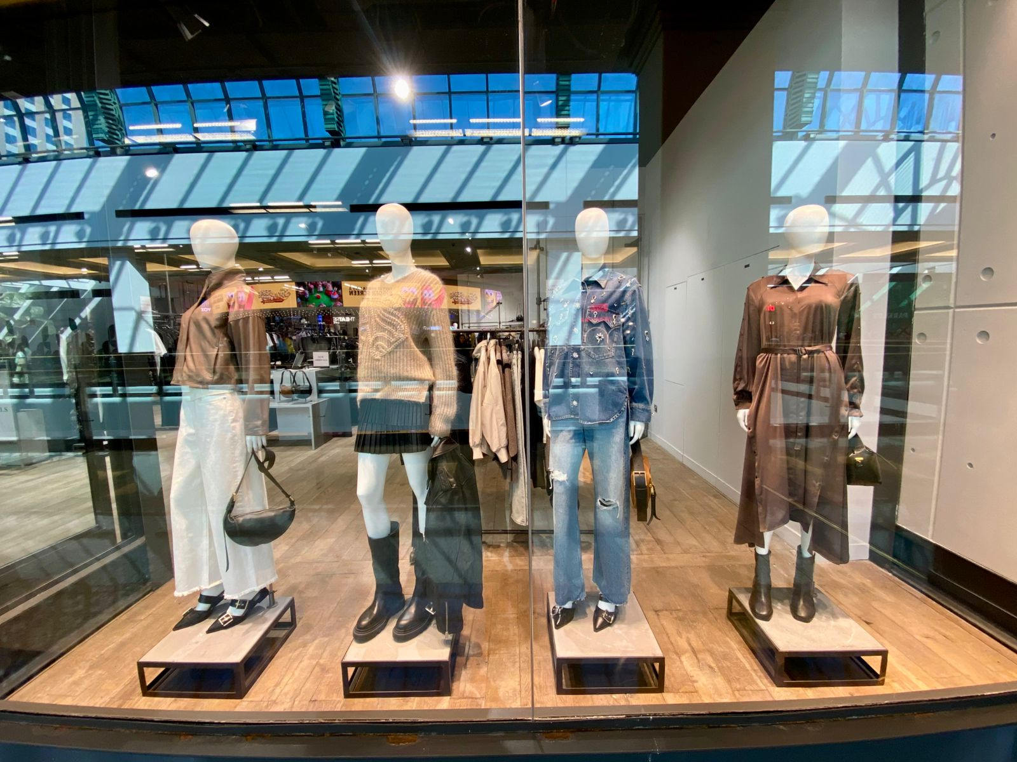
Womenswear.Tender is the Dawn.Spring 2026.January Directive.
BRAND | ACTIVATION | DESCRIPTION | START DATE | END DATE | DURATION | UNITS SOLD | VALUE | BENCHMARK
MOE Allsants | WINDOW | January directive | 01/15/2026 | 01/31/2025

Slide 7
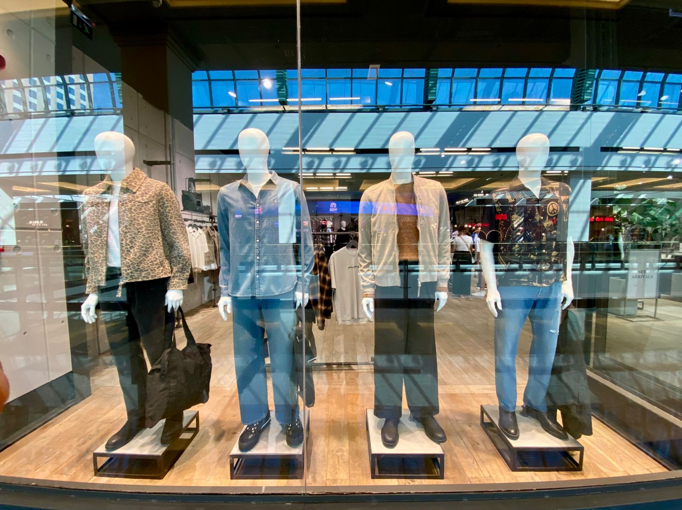
Menswear.Field Trip.Spring 2026.January Directive.
BRAND | ACTIVATION | DESCRIPTION | START DATE | END DATE | DURATION | UNITS SOLD | VALUE | BENCHMARK
MOE Allsaints | WINDOW | January directive | 01/31/2026 | 01/15/2026 | 2 weeks | 9 | 6,745.71

